Slide 1


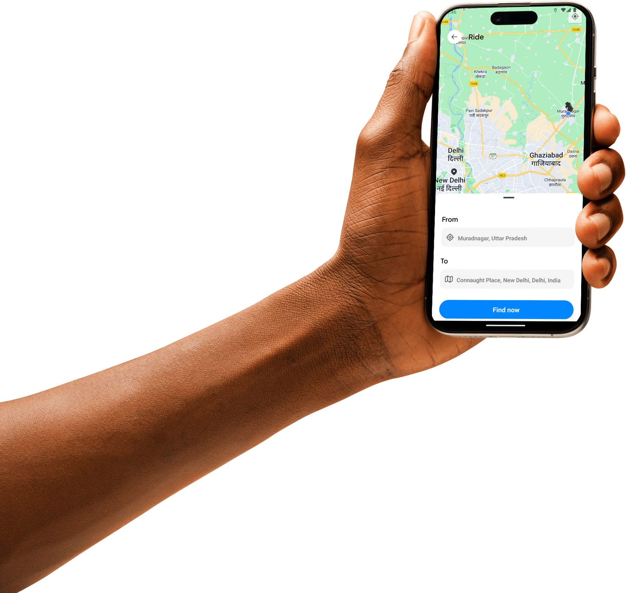

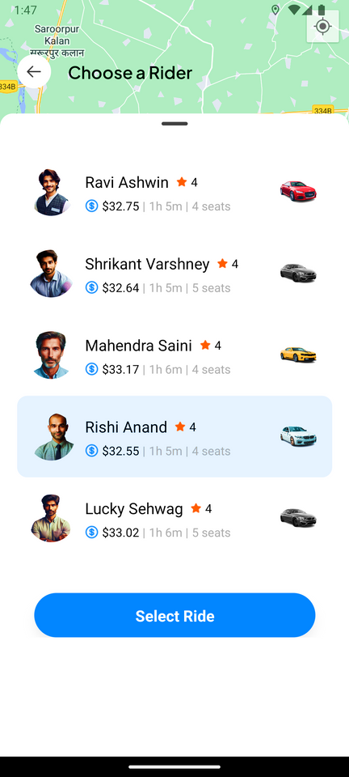
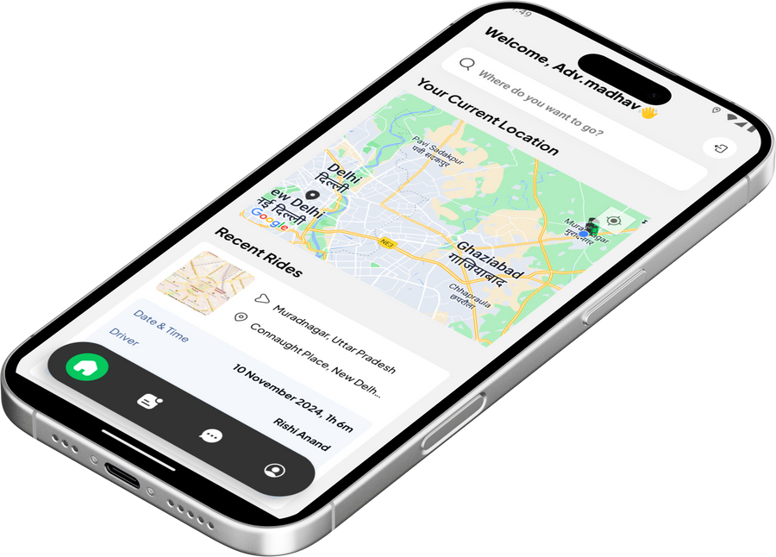

Slide 2

Mini Project (KCA353)
Odd Semester
Session 2024-25
GB09: ChaloRidePe
Meenakshi Bharadwaj (2300290140102)
Murari Kumar Jha (2300290140105)
Nikhil Chaudhary (2300290140107)
Pawan Gangwar (2300290140113)
Project Supervisor:
Ms. Monika Kansal
Assistant Professor

Slide 3

Project Abstract
Today's urban settings demand dependable and effective transportation. As the need for smooth travel options in crowded places grows, ChaloRidePe shows up as a vibrant and easy-to-use ride-hailing service. Whether you're traveling to work, attending an important meeting, or exploring new areas of the city, it enables passengers to communicate in real-time with local drivers, guaranteeing a seamless and stress-free journey. ChaloRidePe offers real-time transportation scheduling, precise fare predictions, and safe cashless payment processing. It provides a smooth and safe experience because of its user-friendly interface, which is improved with safety measures and robust validations to guarantee legitimate users. Without the hassles of conventional transportation alternatives, users may easily book trips and complete transactions. ChaloRidePe is a useful tool for traversing today's hectic cities because of its emphasis on client comfort, safety, and efficiency. It offers a dependable, easily available alternative to urban commuting, perfect for both impromptu travel and routine commutes.

Slide 4

Project Objectives and Goals
The primary goal of ChaloRidePe is to cater to its audience, including passengers.
Convenience: Easy to use and understand
Affordability: To provide affordable rides to users
Accessibility to all users
Safety: Legitimate Users
Reliability: Available whenever the user requires it and reliable to them.

Slide 5



Alignment with UN Sustainable Development Goals (SDGs)
SDG 8: Decent Work and Economic Growth
The app creates economic opportunities for local drivers, enabling them to earn income through flexible work. It also promotes local economic activity by making travel and commuting more accessible and efficient.
SDG 9: Industry, Innovation, and Infrastructure
ChaloRidePe leverages technology to improve transportation infrastructure, addressing urban mobility issues through innovative, tech-driven solutions.

Slide 6








Technology (Hardware and Software Requirements)
Hardware Requirements
Processor: Intel(R) Core(TM) i5-9300H CPU @ 2.40 GHz
RAM: 8.00 GB
System Type: 64-bit operating system, x64-based processor
Storage Required: Maximum Up to 16 GB
Software Requirements
Operating System: Windows 11, Version 23H2
Code Editor: Visual Studio Code, v1.93.1
Frontend: React Native Expo, Typescript, Tailwind CSS
Backend: Neon DB, PostgreSQL
Authentication: Clerk Authentication Services
APIs: Here Maps Geocoding and Search API; Here Maps Routing API
Payment Integration: Stripe Payment Services

Slide 7
Workflow
Input Destination
Find Ride
Select Driver
and Confirm Ride
Book Ride
User
Back To Home
Confirmation message
Payment

Slide 8
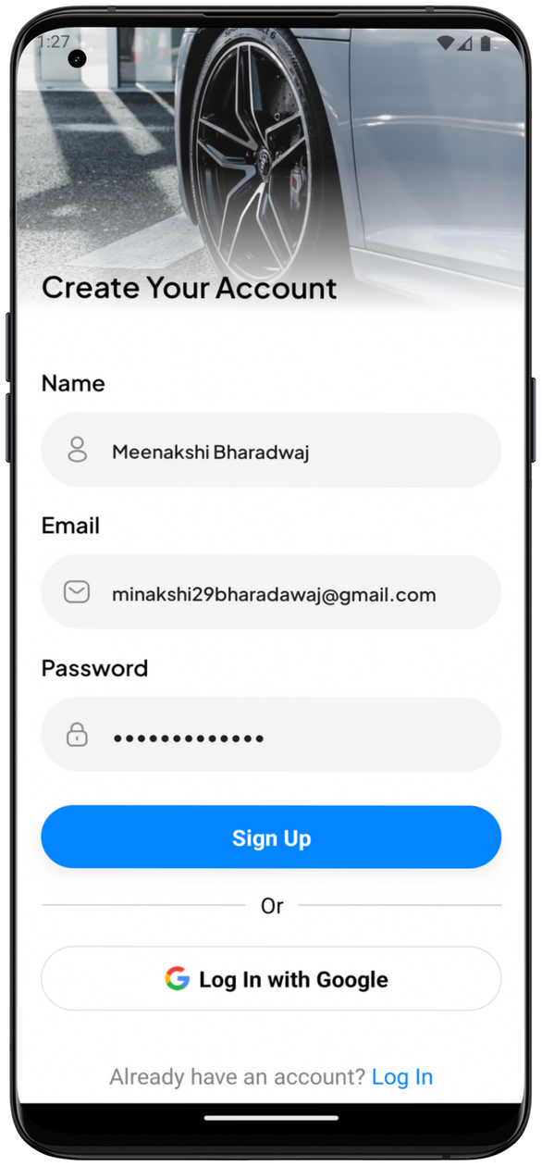
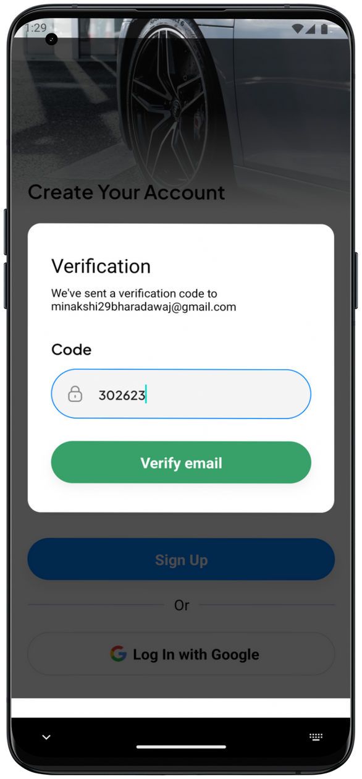
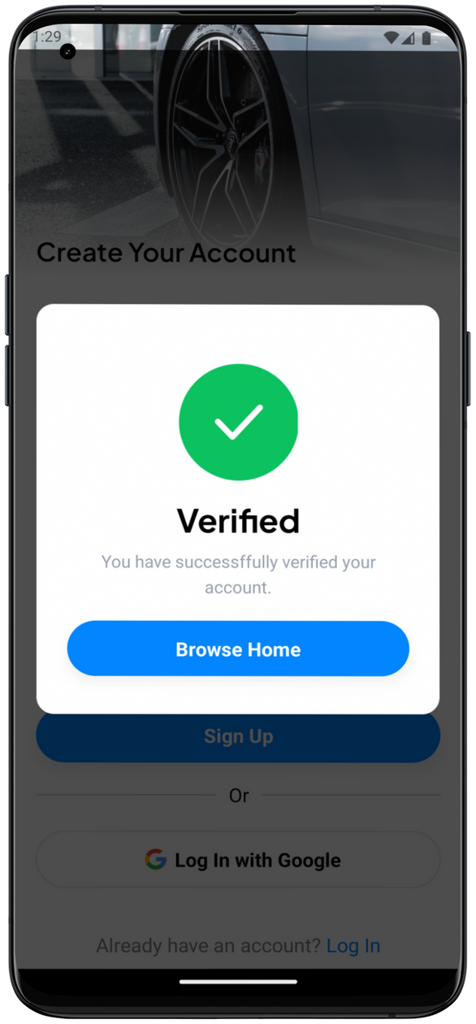
Methodology and Approach
Module 1: Authentication
Sign Up: User signup using email and password
Login: User login using email ID and password.
Login with Google: User login with Google Accounts
Authentication Services: Clerk Authentication Services such as email OTP, Google OAuth, etc.

Slide 9
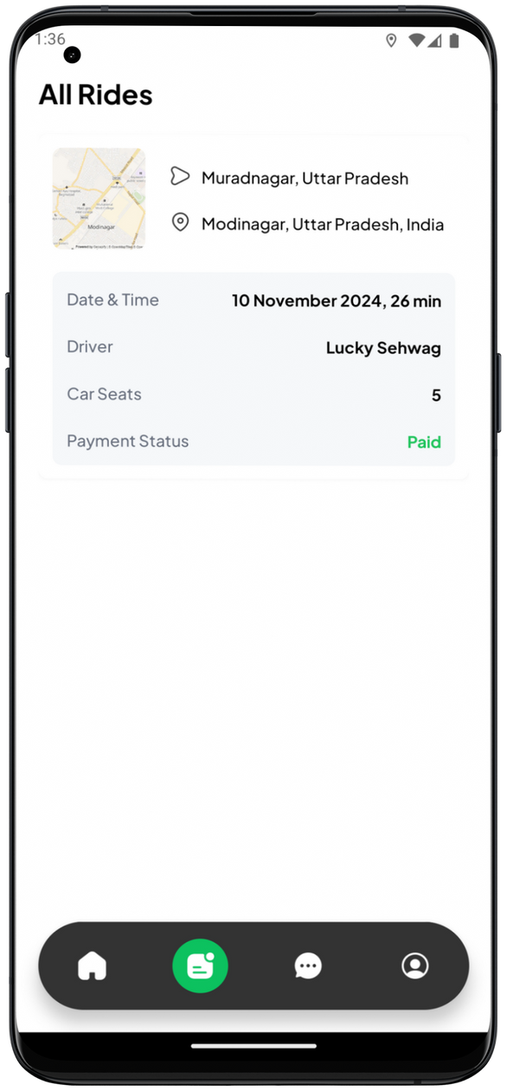

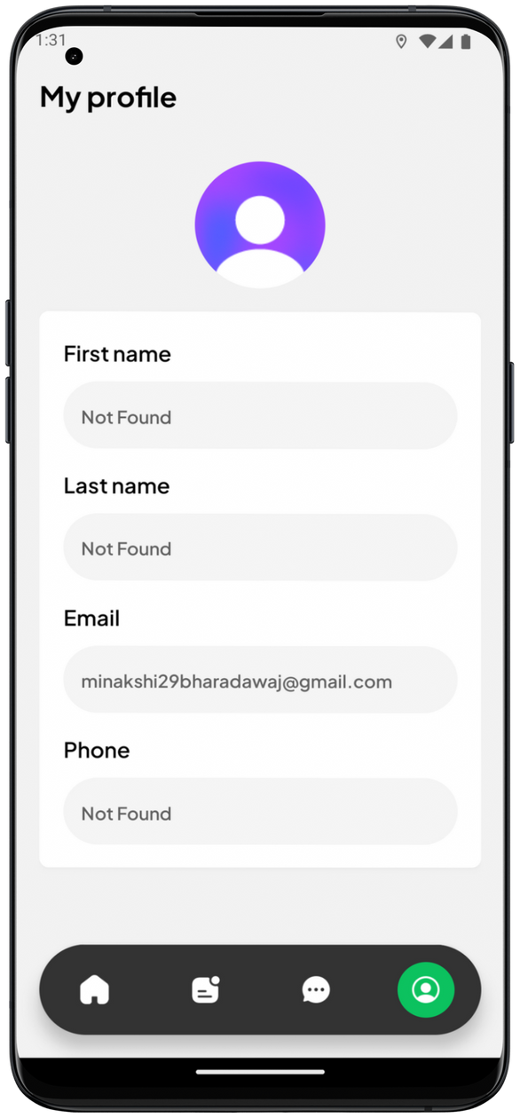
Methodology and Approach
Module 2: User Profile
User information:
Profile picture, first name, last name.
email, phone number.
Ride History: Past rides information.
Chat Tab: For communication functionality.

Slide 10
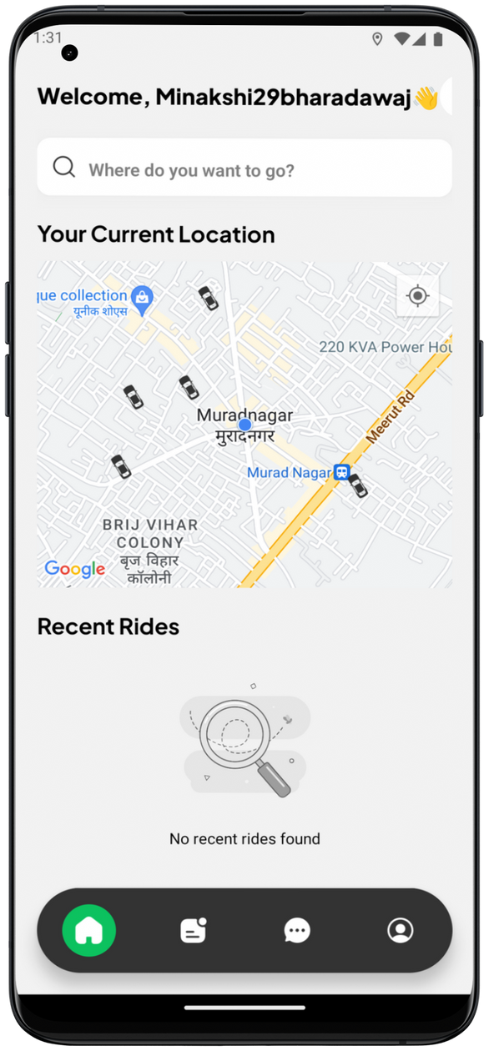
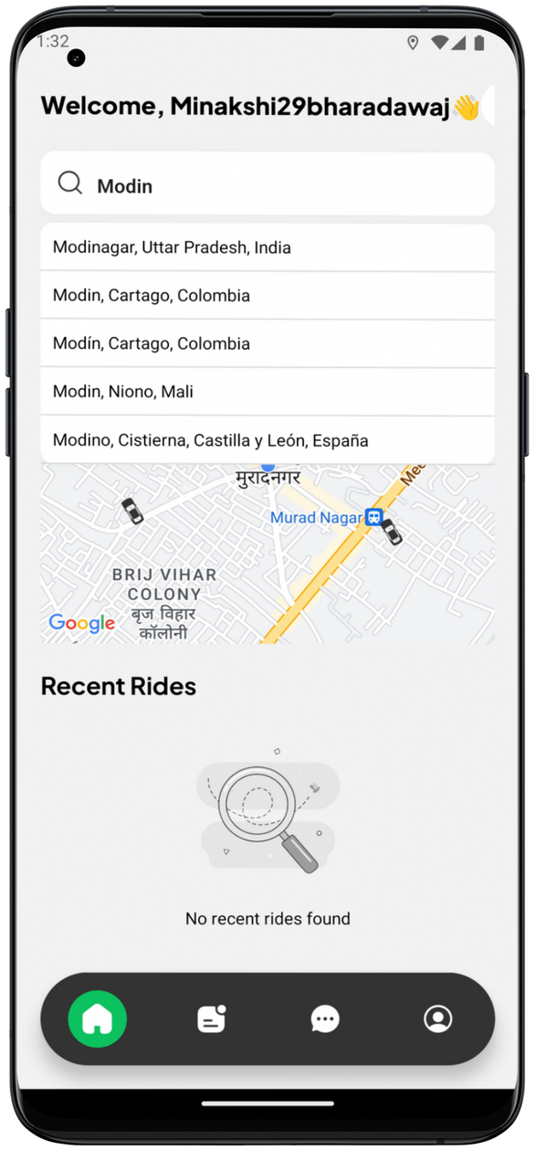
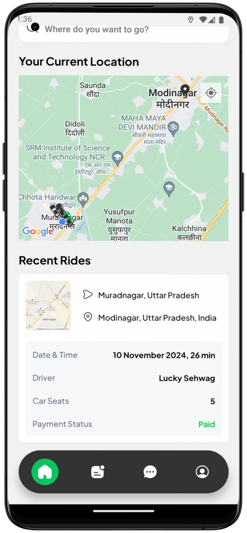
Methodology and Approach
Module 3: Map and Location Services
Location services: Integration with a mapping API (Here Maps API).
Location Permissions: Real-time location tracking, such as current live user location.
Geocoding and reverse geocoding.

Slide 11
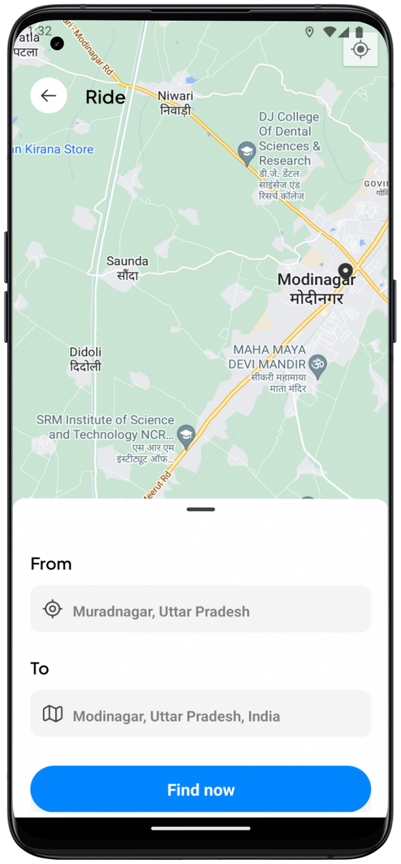
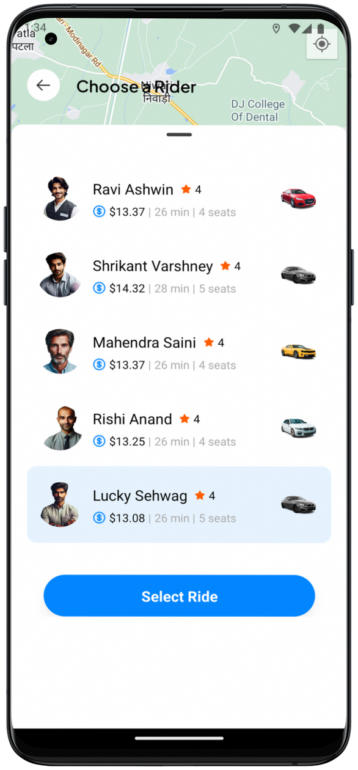
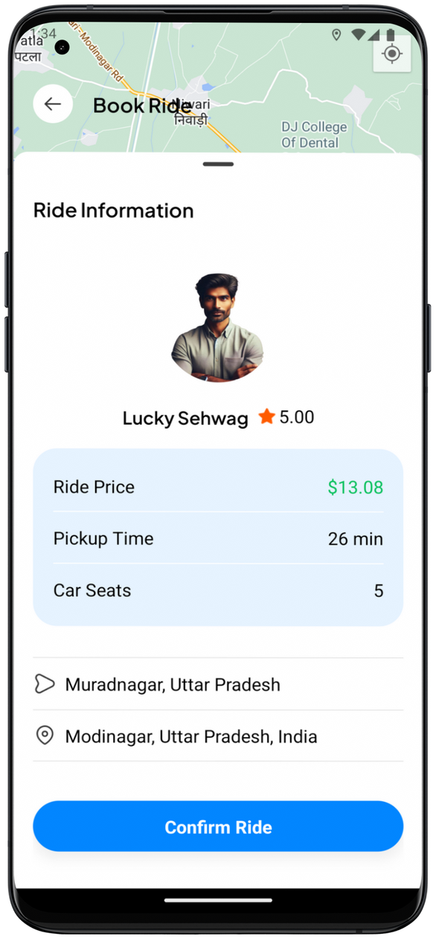
Methodology and Approach
Module 4: Find and Confirm Ride
Find Ride: Search rides for pickup and destination locations.
Driver Selection: Select driver with best ride.
Confirm Ride: Review ride details.

Slide 12
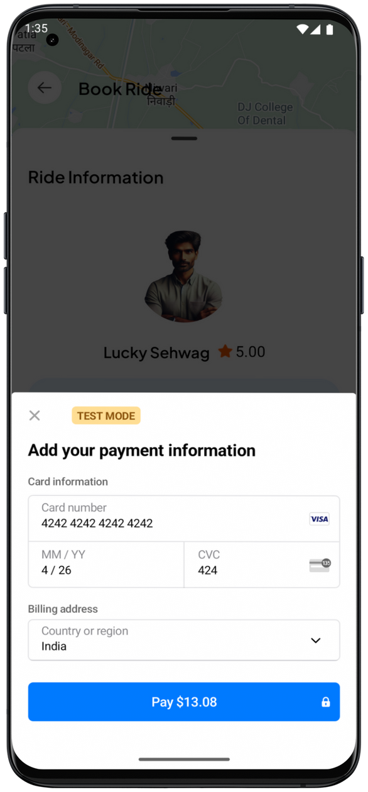
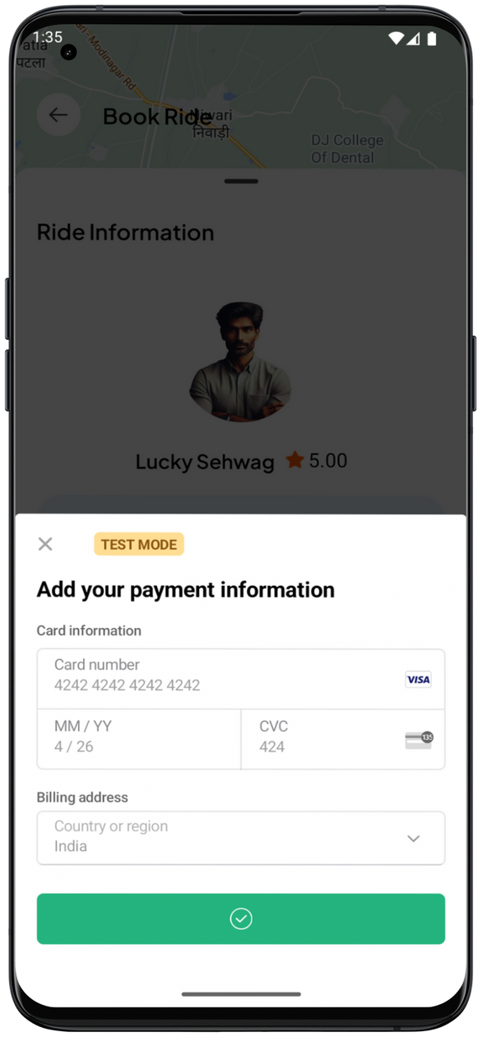
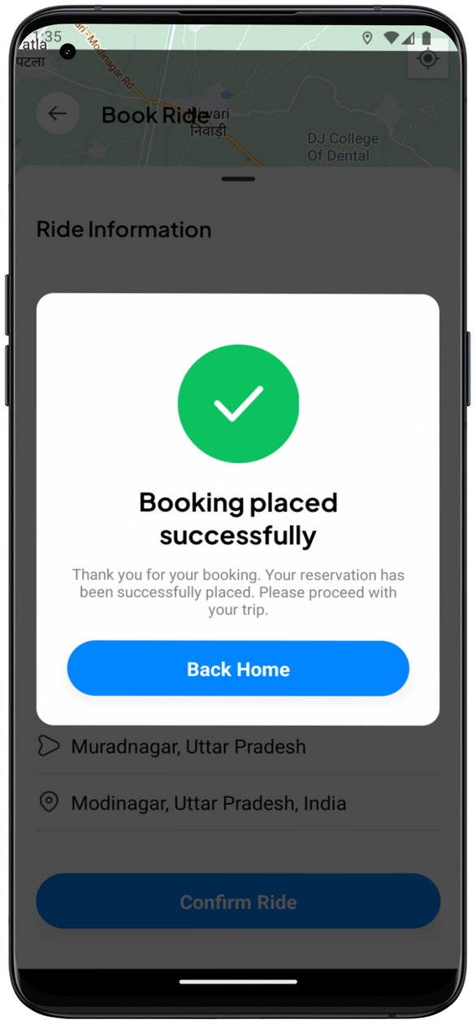
Methodology and Approach
Module 5: Payments
Payment Services: Payment integration using services such as Stripe Payment Service.
Payment methods: Payment options such as debit/credit card payment, etc.
Payment Success: Payment confirmation message informing about successful transaction.

Slide 13
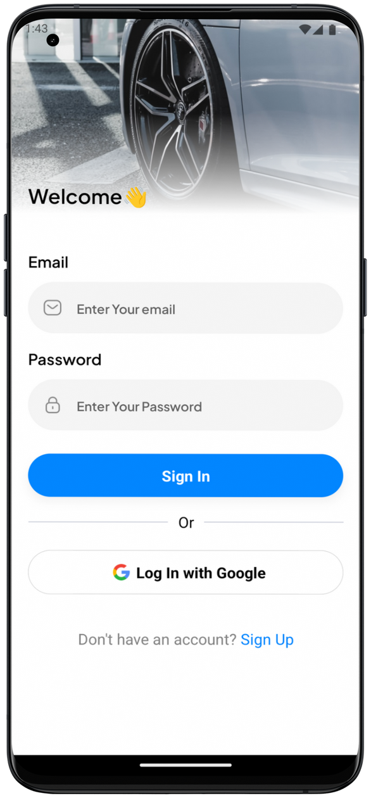
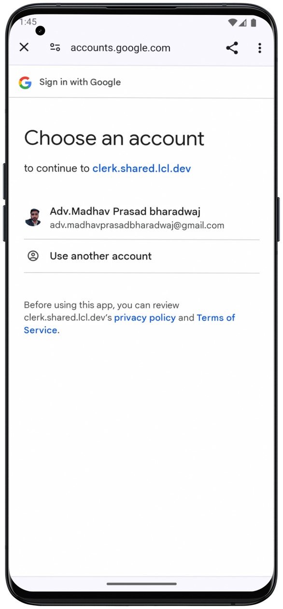
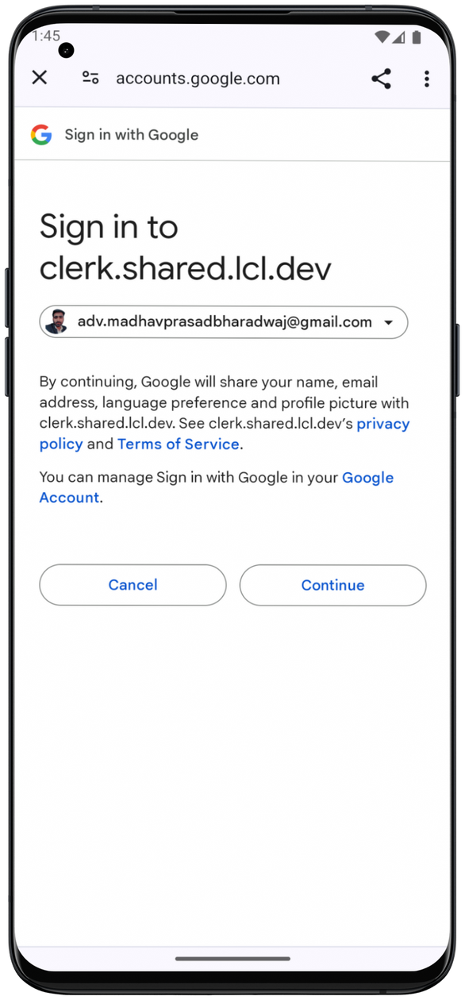
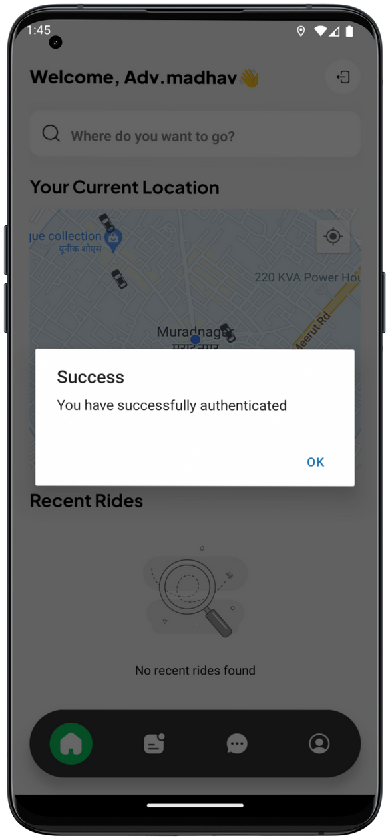
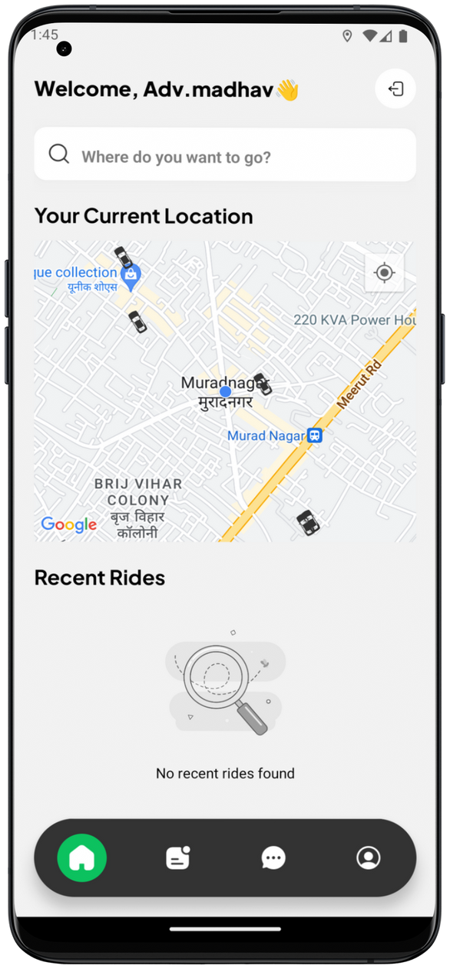
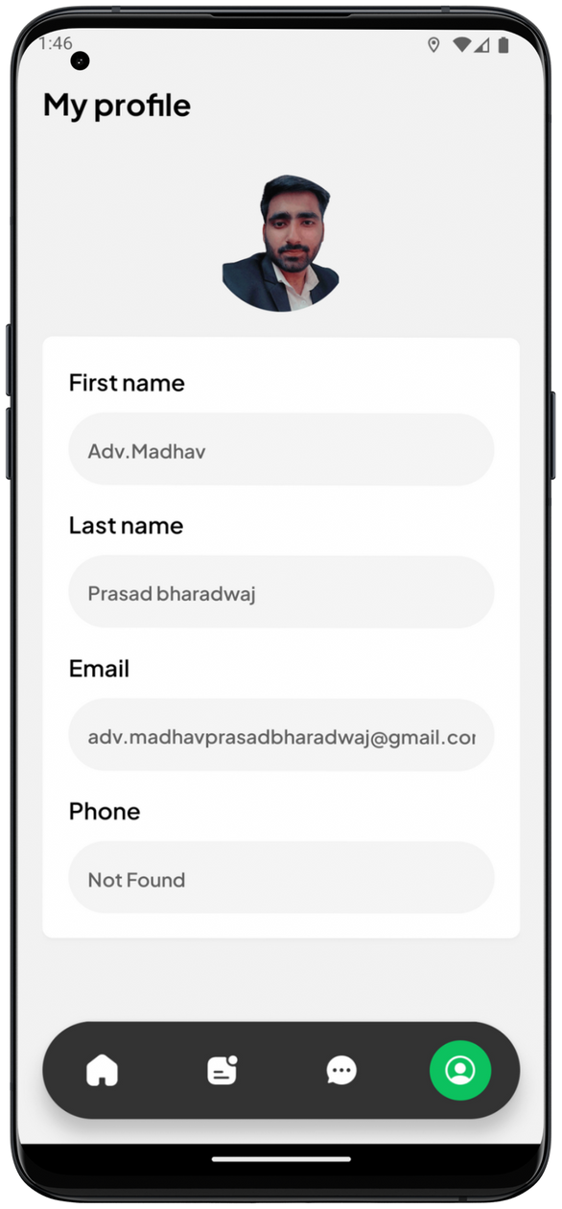
Google OAuth Authentication

Slide 14

Project Outcomes
Convenience and Accessibility
Flexibility
Safety

Slide 15
References
https://www.zetaton.com/blog/ride-hailing-apps
https://www.uber.com/
https://www.rodbez.in/
https://indrive.com/
https://www.olacabs.com/
https://www.here.com/docs/bundle/geocoding-and-search-api-developer-guide/page/topics/quick-start.html
https://www.clerk.com
https://www.stripe.com
https://stackoverflow.com/questions/56417594/how-to-make-polyline-follow-roads-in-react-native-maps-with-here-api

Slide 16
Thank you!

